Slide 1
Introduction to AI and Machine Learning

Slide 2
Learning Goals
In this section, we will cover:
- Definitions
- Machine Learning Terminology
- Types of Machine Learning
- Deep Learning
- History of AI

Slide 3
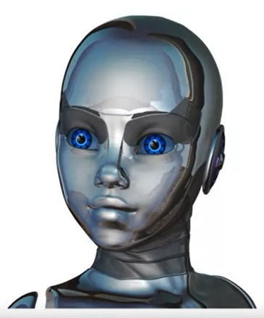
Artificial Intelligence & Machine Learning
In this overview, we will discuss:
Define "Artificial Intelligence” (AI), "Machine Learning” (ML), and “Deep Learning” (DL).
Explain how DL helps solve classical ML limitations.
Explain key historical developments, and the “hype-Al winter cycle.”
Differentiate modern Al from prior Al.
Relate sample applications of AI.
Al robot

Slide 4
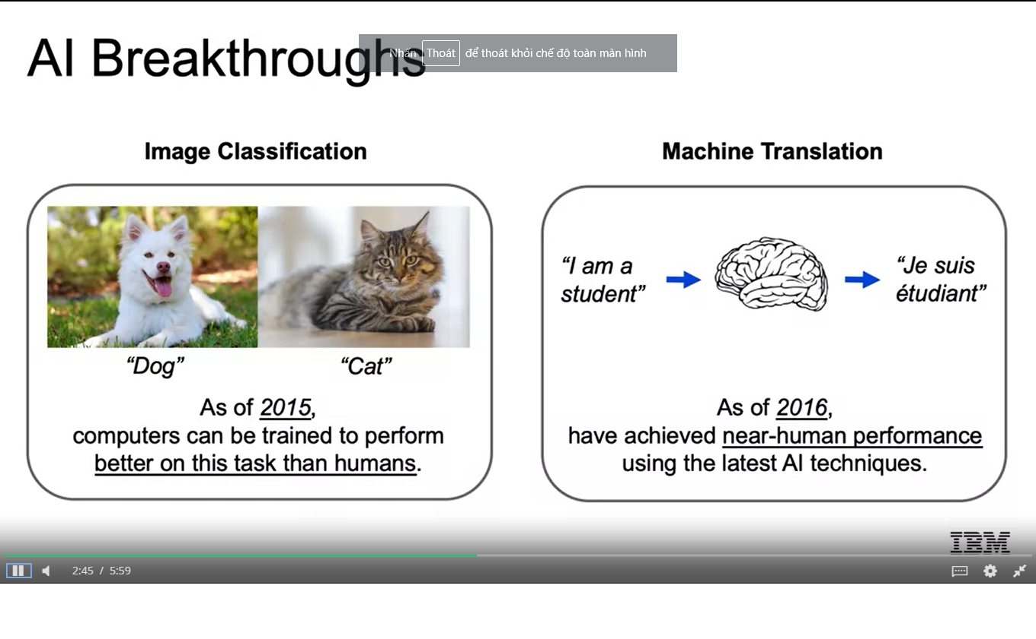
Al Breakthroughs

Slide 5
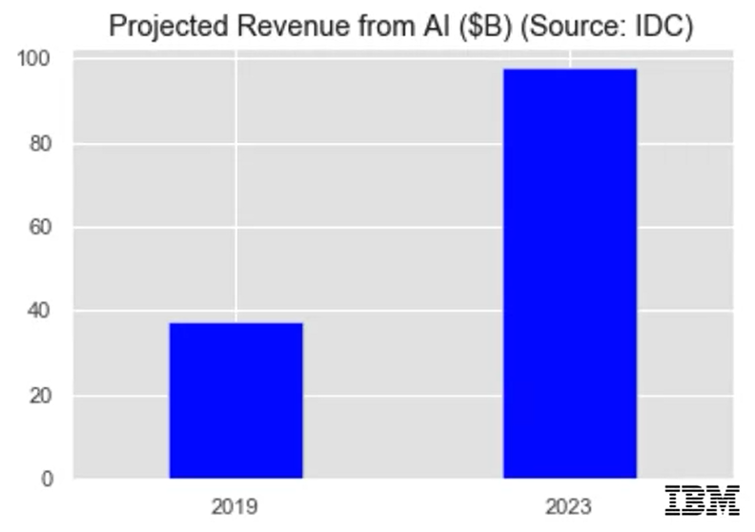
Al is the New Electricity
“About 100 years ago, electricity transformed every major industry. Al has advanced to the point where it has the power to transform … every major sector in coming years.”
-Andrew Ng,
Stanford University

Slide 6
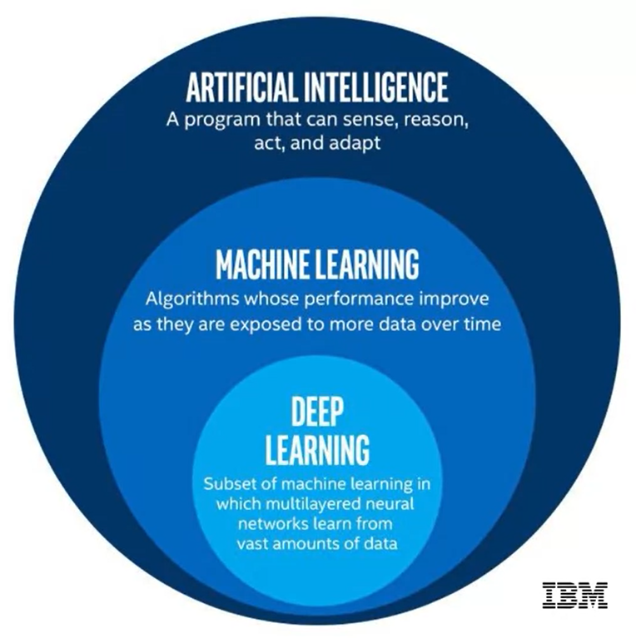
Definitions
- Artificial Intelligence (AI)
- Machine Learning (ML)
- Deep Learning (DL)

Slide 7
Artificial Intelligence
“A branch of computer science dealing with the simulation of intelligent behavior in computers.” - Merriam-Webster
“Colloquially, the term ‘artificial intelligence’ is applied when a machine mimics ‘cognitive’ functions that humans associate with other human minds, such as ‘learning’ and ‘problem solving’.” - Wikipedia

Slide 8
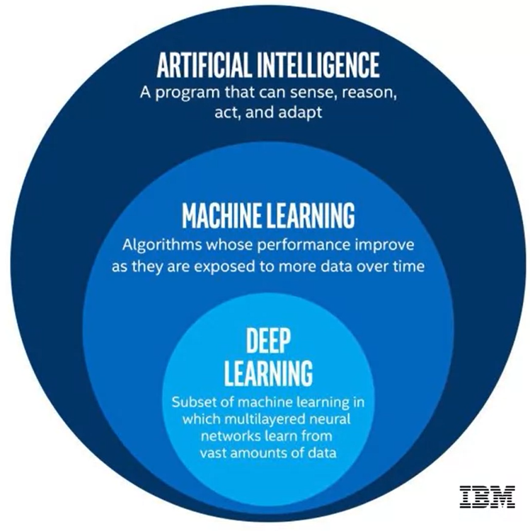
Machine Learning
“The study and construction of programs that are not explicitly programmed, but learn patterns as they are exposed to more data over time.”

Slide 9
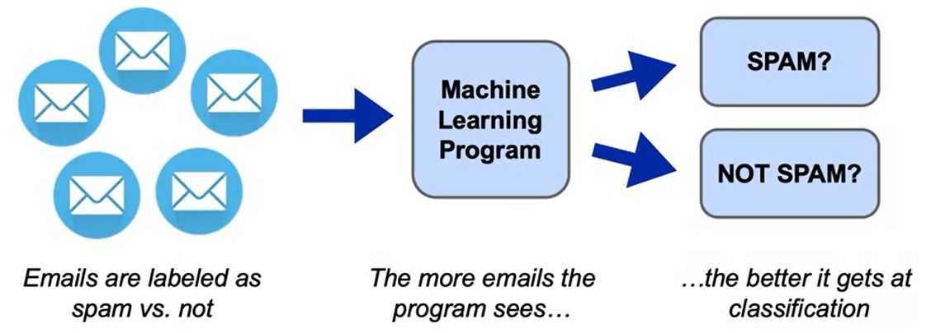
Machine Learning
These programs learn from repeatedly seeing data, rather than being explicitly programmed by humans.

Slide 10
Machine Learning Terminology
In this example, we learn to classify flower species from a set of measurement features.
sepal length | sepal width | petal length | petal width | species
6.7 | 3.0 | 5.2 | 2.3 | virginica
6.4 | 2.8 | 5.6 | 2.1 | virginica
4.6 | 3.4 | 1.4 | 0.3 | setosa
6.9 | 3.1 | 4.9 | 1.5 | versicolor
4.4 | 2.9 | 1.4 | 0.2 | setosa
4.8 | 3.0 | 1.4 | 0.1 | setosa
5.9 | 3.0 | 5.1 | 1.8 | virginica
5.4 | 3.9 | 1.3 | 0.4 | setosa
4.9 | 3.0 | 1.4 | 0.2 | setosa
5.4 | 3.4 | 1.7 | 0.2 | setosa
Features
(attributes of the data)
Target
(column to be predicted)

Slide 11
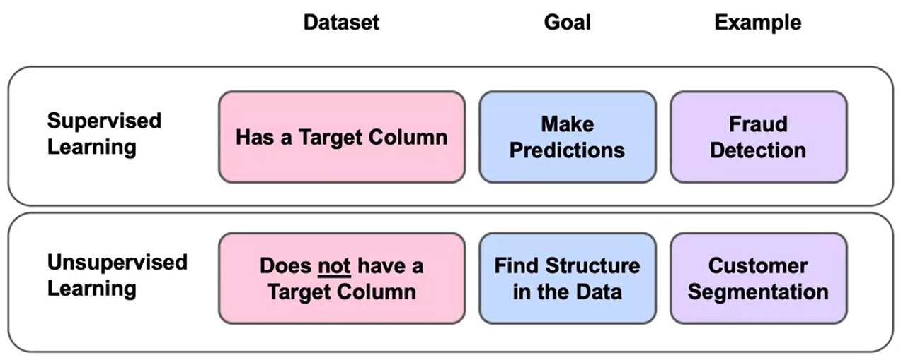
Two Main Types of Machine Learning

Slide 12
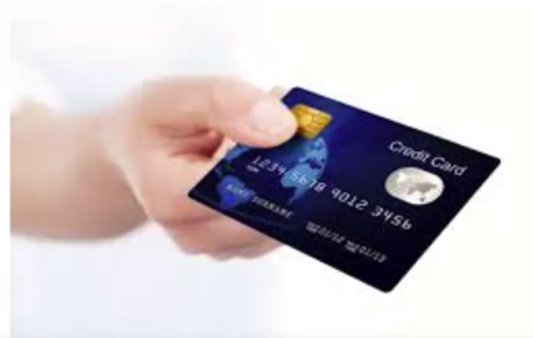
Machine Learning Example
Suppose you wanted to identify fraudulent credit card transactions.
You could define features to be:
Transaction time
Transaction amount
Transaction location
Category of purchase
The algorithm could learn what feature combinations suggest unusual activity.
Credit card transactions

Slide 13
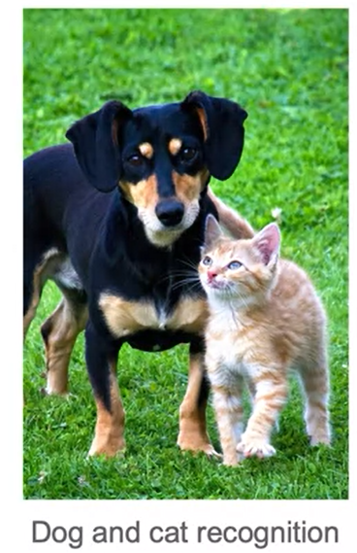
Machine Learning Limitations
- Suppose you wanted to determine if an image is of a cat or a dog.
- What features would you use?
- This is where Deep Learning can come in.

Slide 14
Deep Learning
“Machine learning that involves using very complicated models called “deep neural networks”.
Models determine best representation of original data; in classic machine learning, humans must do this.

Slide 15
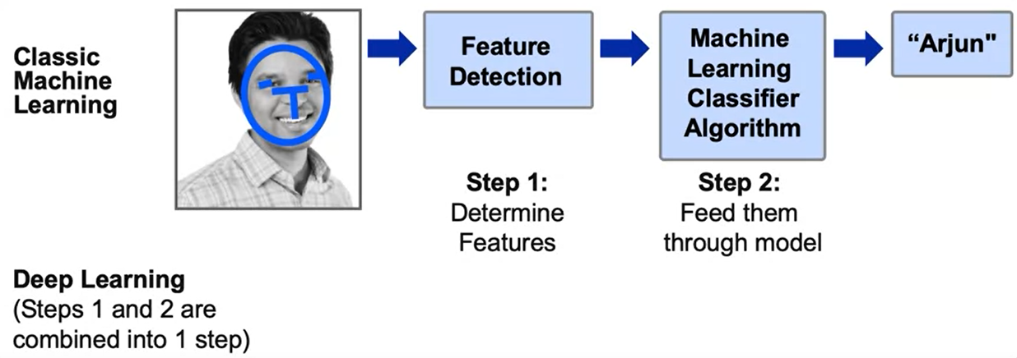
Deep Learning Example

Slide 16
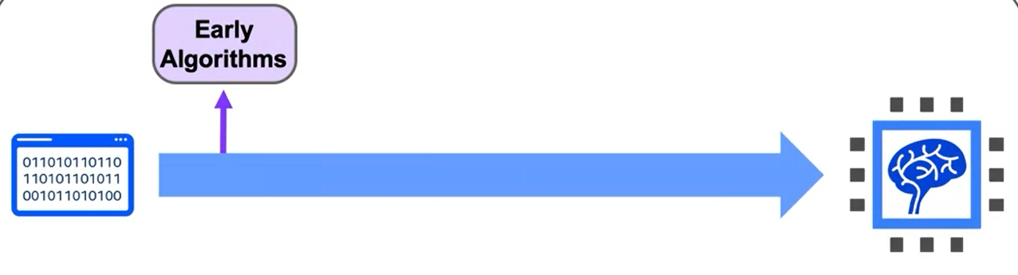
History of AI
Al has experienced several hype cycles, where it has oscillated between periods of excitement and disappointment.

Slide 17
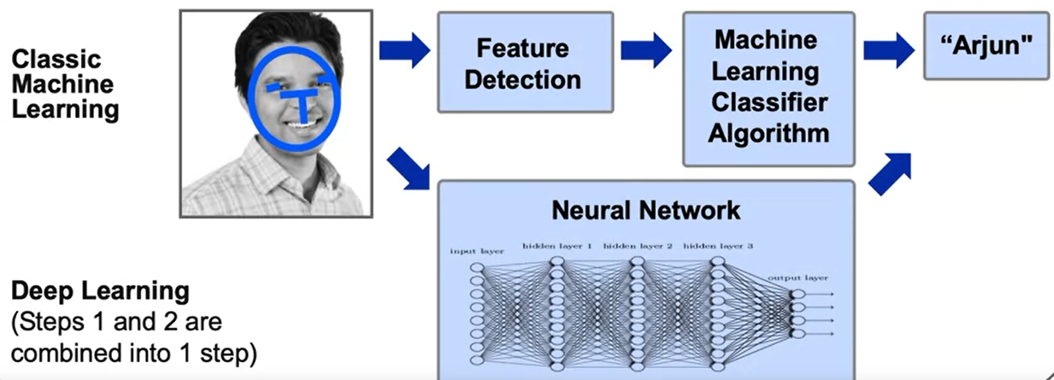
Deep Learning Example

Slide 18
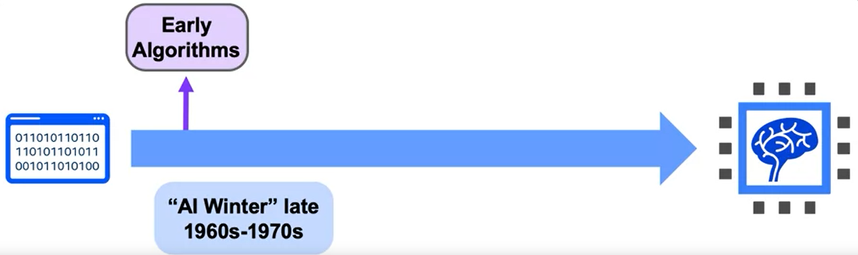
History of AI
Al has experienced several hype cycles, where it has oscillated between periods of excitement and disappointment.

Slide 19
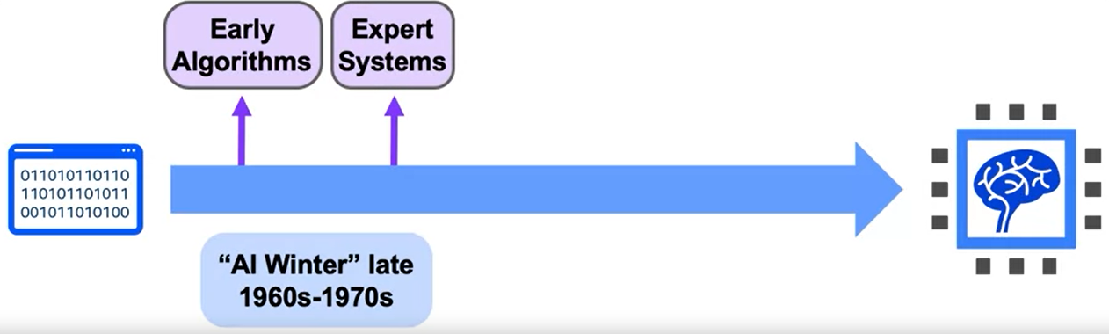
History of AI
Al has experienced several hype cycles, where it has oscillated between periods of excitement and disappointment.

Slide 20
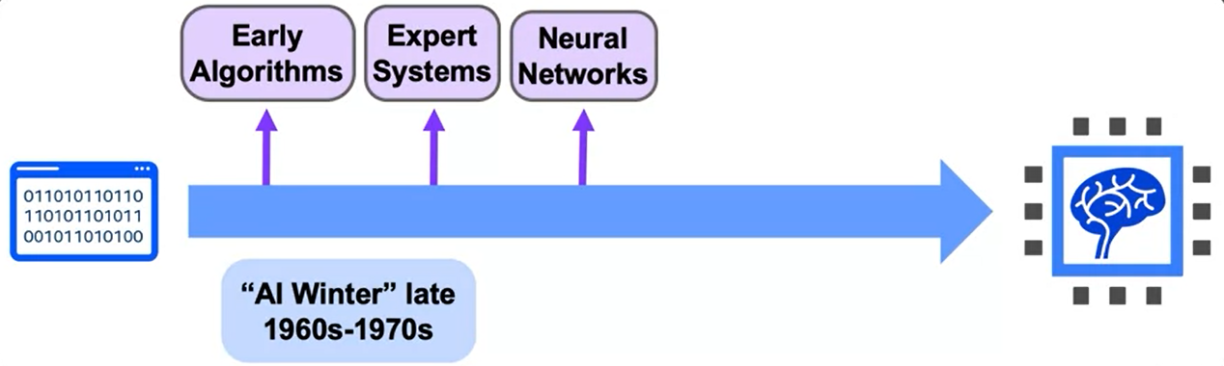
History of AI
Al has experienced several hype cycles, where it has oscillated between periods of excitement and disappointment.

Slide 21
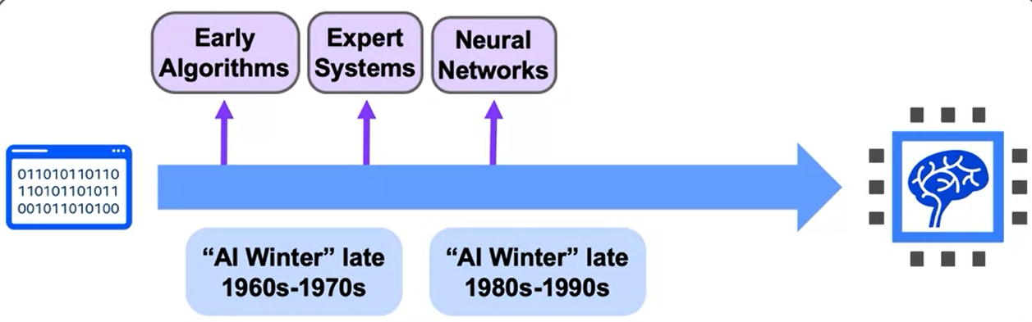
History of AI
Al has experienced several hype cycles, where it has oscillated between periods of excitement and disappointment.

Slide 22
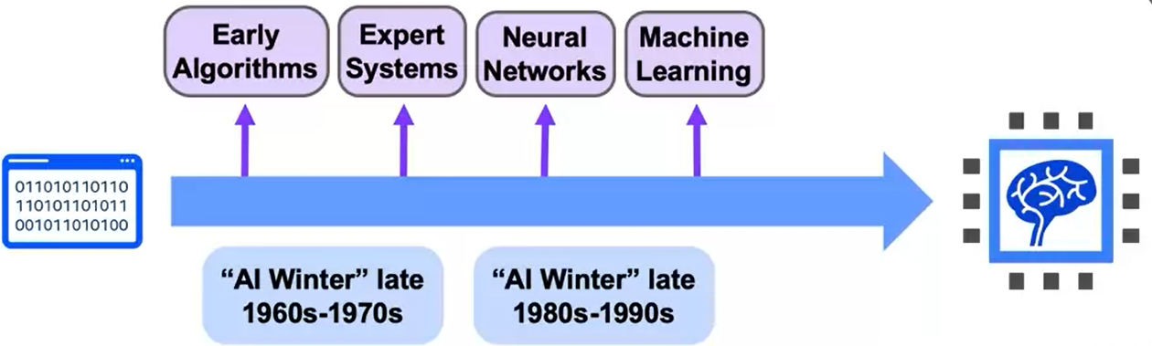
History of AI
Al has experienced several hype cycles, where it has oscillated between periods of excitement and disappointment.

Slide 23
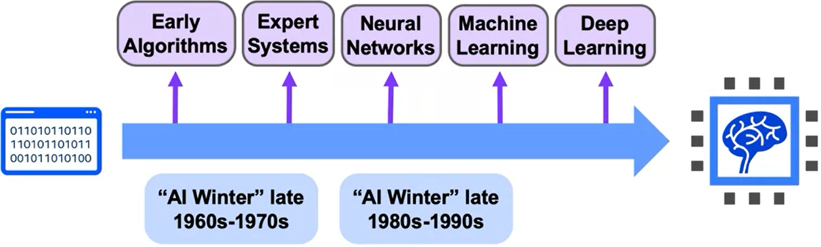
History of AI
Al has experienced several hype cycles, where it has oscillated between periods of excitement and disappointment.

Slide 24
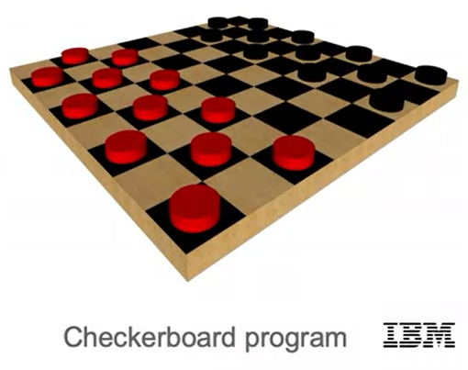
1950s: Early AI
1950: Alan Turing developed the Turing test, to test a machine's ability to exhibit intelligent behavior.
1956: Artificial Intelligence was accepted as a field at the Dartmouth Conference.
1957: Frank Rosenblatt invented the perceptron algorithm. This was the precursor to modern neural networks.
1959: Arthur Samuel published an algorithm for a checkers program using machine learning.

Slide 25
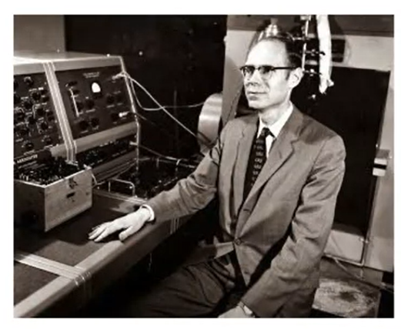
The First “Al Winter"
1966: ALPAC committee evaluated Al techniques for machine translation and determined there was little yield from the investment.
1969: Marvin Minsky published a book on the limitations of the Perceptron algorithm which slowed research in neural networks.
1973: The Lighthill report highlights Al's failure to live up to promises.
The two reports led to cuts in government funding for Al research, leading to the first “Al Winter".
John R. Pierce, head of ALPAC

Slide 26
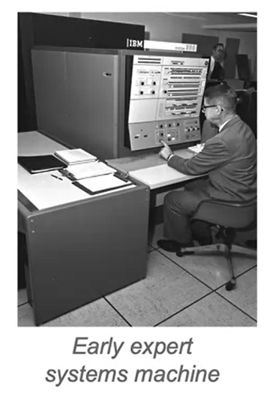
1980's Al Boom
Expert Systems - systems with programmed rules designed to mimic human experts.
Ran on mainframe computers with specialized programming languages (e.g. LISP).
Were the first widely-used Al technology, with two-thirds of "Fortune 500" companies using them at their peak.
1986: The “Backpropagation" algorithm is able to train multi-layer perceptrons, leading to new successes and interest in neural network research.

Slide 27
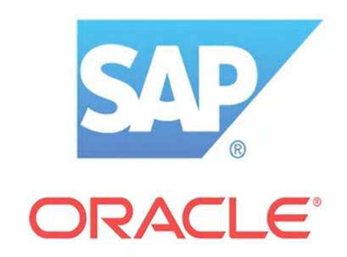
Another Al Winter (1980s –1990s)
Expert systems' progress on solving business problems slowed.
Expert systems began to be melded into software suites of general business applications (e.g. SAP®, Oracle®) that could run on PCs instead of mainframes.
Neural networks didn't scale to large problems.
Interest in Al in business declined.
Software companies

Slide 28
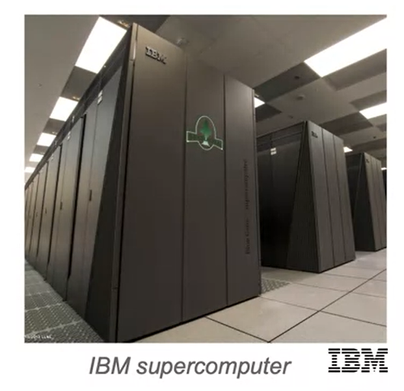
1990s - 2000s: Machine Learning
Al solutions had successes in speech recognition, medical diagnosis, robotics, and many other areas.
Al algorithms were integrated into larger systems and became useful throughout industry.
The Deep Blue chess system beat world chess champion Garry Kasparov.
Google's search engine launched using artificial intelligence technology.

Slide 29
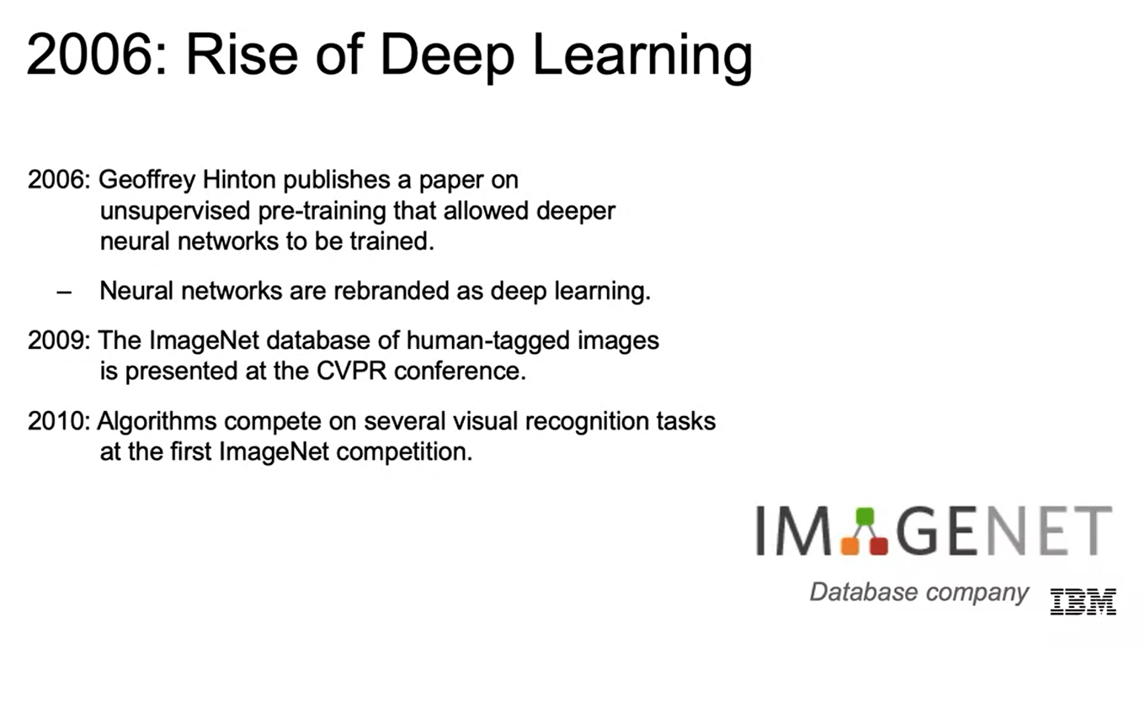
2006: Rise of Deep Learning
2006: Geoffrey Hinton publishes a paper on unsupervised pre-training that allowed deeper neural networks to be trained.
- Neural networks are rebranded as deep learning.
2009: The ImageNet database of human-tagged images is presented at the CVPR conference.
2010: Algorithms compete on several visual recognition tasks at the first ImageNet competition.

Slide 30
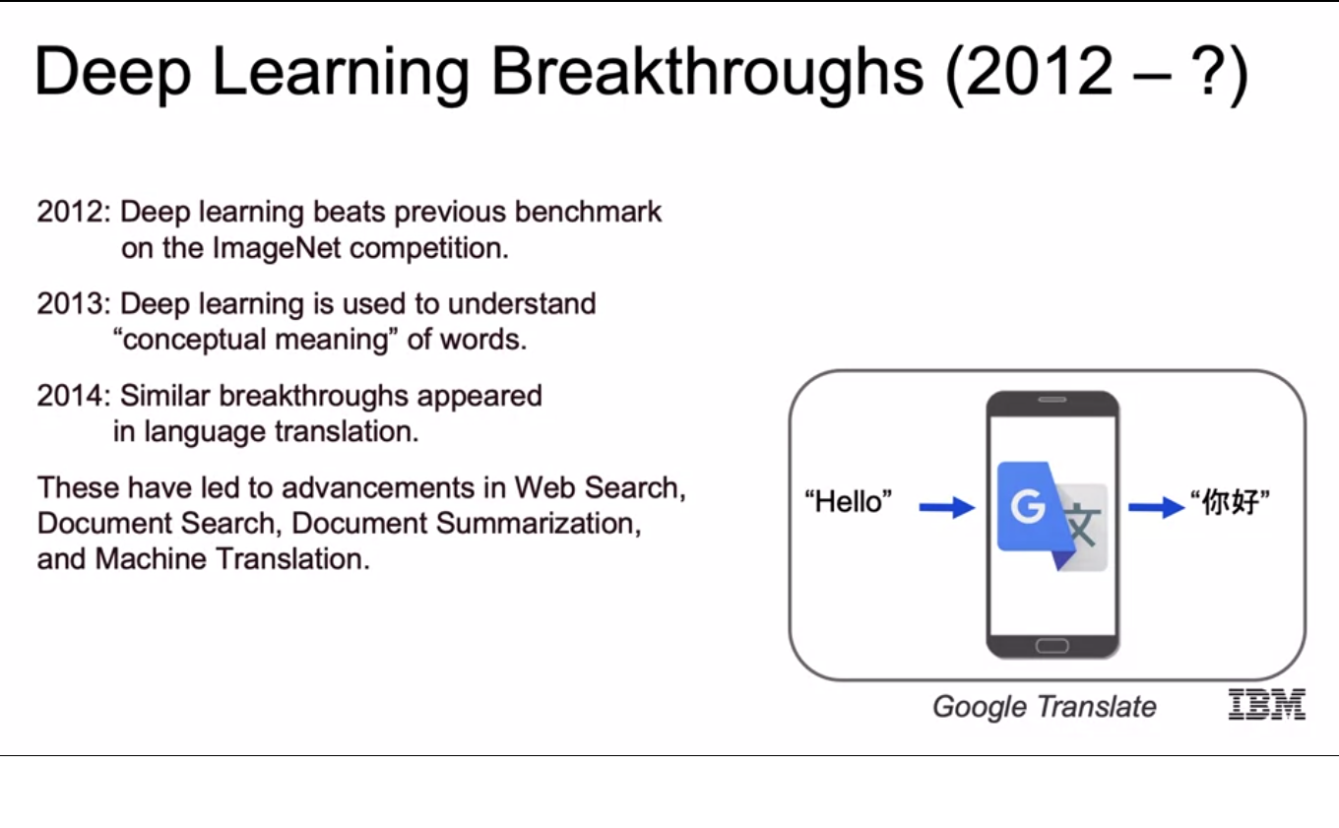
Deep Learning Breakthroughs (2012 – ?)
2012: Deep learning beats previous benchmark on the imageNet competition.
2013: Deep learning is used to understand "conceptual meaning" of words.
2014: Similar breakthroughs appeared in language translation.
These have led to advancements in Web Search, Document Search, Document Summarization, and Machine Translation.

Slide 31
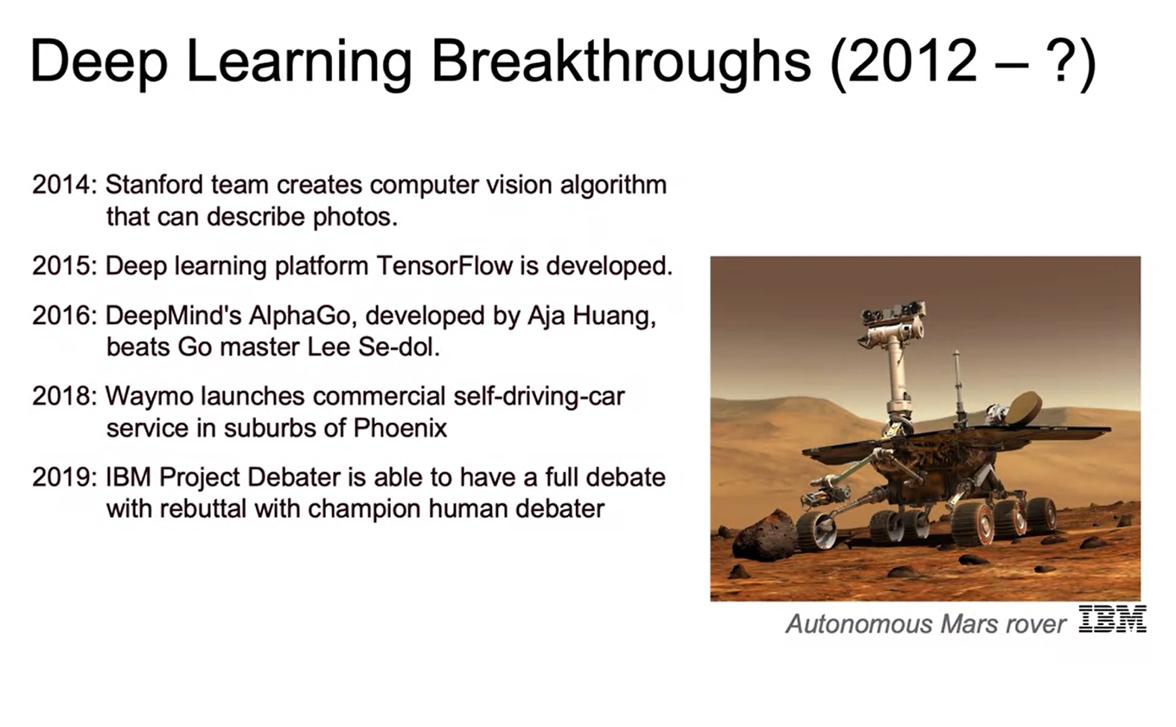
Deep Learning Breakthroughs (2012 – ?)
2014: Stanford team creates computer vision algorithm that can describe photos.
2015: Deep learning platform TensorFlow is developed.
2016: DeepMind’s AlphaGo, developed by Aja Huang, beats Go master Lee Se-dol.
2018: Waymo launches commercial self-driving-car service in suburbs of Phoenix.
2019: IBM Project Debater is able to have a full debate with rebuttal with champion human debater.

Slide 32
Summary
Introduction to Artificial Intelligence and Machine Learning
Artificial Intelligence is a branch of computer science dealing with the simulation of intelligent behavior in computers. Machines mimic cognitive functions such as learning and problem solving.
Machine learning is the study of programs that are not explicitly programmed, but instead these algorithms learn patterns from data.
Deep learning is a subset of machine learning in which multilayered neural networks learn from vast amounts of data.

Slide 33
Summary
History of AI
AI has experienced cycles of AI winters and AI booms.
AI solutions include speech recognition, computer vision, assisted medical diagnosis, robotics, and others.

Slide 34
Learning Recap
In this section, we learned:
- Definitions
- Machine Learning Terminology
- Types of Machine Learning
- Deep Learning
- History of AI

